Slide 1
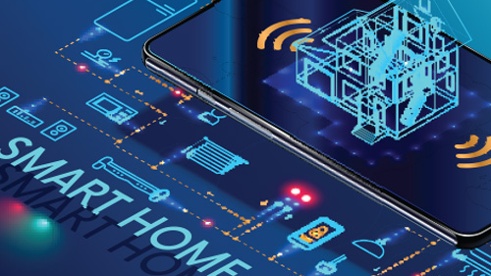
Smart Home
Neaz Mahmud
Asm Nurussafa
Tasawar Siddiquy
Credit: Andrey Suslov/shutterstock.com

Slide 2

What Does Smart Home Mean?
Smart Home System or Artificial Intelligent Homes means automation and control of the electrical appliance with Artificial Intelligent. It can also be remotely controlled by electronic devices.

Slide 3
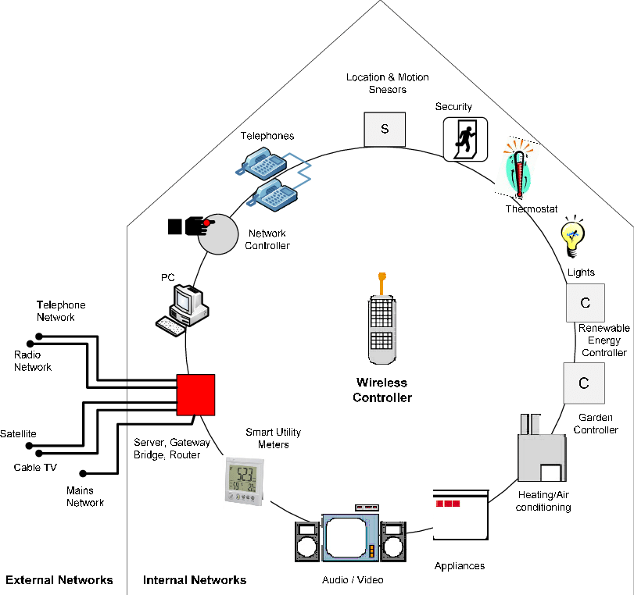
Architectural Overview
Al-Qutayri, Mahmoud & Jeedella, Jeedella. (2010). Integrated Wireless Technologies for Smart Homes Applications. 10.5772/8412.

Slide 4

Different Method Or Techniques Can Be Used To Control Smart Home Appliances .
Smart Home System Based on DTMF Technology.
Specific signal from mobile phone digit to perform specific task.
The unique signal (tone) generated by the digit of a DTMF keypad enables the system to perform previously specified task automatically.
The system requires a mobile phone and a DTMF transmitter to send signal.
The signal is then decoded and send to microcontroller to perform its specified operation.
Smart Home System Based on GSM
Commands are sent as SMS to GSM module which receives the message and send it to microcontroller board to implement the command.
With the help of relay module, the microcontroller board turns on/off the specific appliances.

Slide 5

C. Smart Home System Based on Voice Recognition (Zigbee).
# 3 major modules namely microphone module, Zigbee coordinator and Terminals.
# A smart phone/a desktop computer/ a smart Tablet/ a laptop connected to Zigbee coordinator module.
# The terminals can perform different specified task such as monitoring and control of temperature, gas, humidity, appliance switching and so on.
# To perform these tasks, different sort of sensors and appliance control circuit are needed to be installed.
D. Smart Home System Based on Wi-fi and Internet.
# This system is divided into 3 major parts: remote environment, home gateway and home environment.
# For monitoring and controlling appliances remotely, remote environment is used.
# The system supports 3G and 4G internet, Wi-fi system and can be controlled by android app.
# The user sends command from android app which gets transferred through internet.
# The system is protected by firewall which ensures security.

Slide 6


Smart Home Based on Bluetooth Module, Smart Phone App and Microcontroller
The system consists of a smart app with user-friendly and easy to use GUI, Bluetooth module to transfer command from smart phone to microcontroller board and appliance control circuit to control appliances.
Smart phone to Bluetooth module wireless
from. The Bluetooth module transfers the command to a microcontroller board connected to it. The microcontroller board plays the role of central controller unit.
Different sort of sensors having different functions can be incorporated with such sort of smart home system for different purposes which make this system versatile and compatible
F. Gesture Controlled
Gesture controlled smart home systems generally requires a camera to record human gestures. Then, the images of gesture go through the process of image training. Based on a particular gesture, the system performs the pre-defined task.

Slide 7
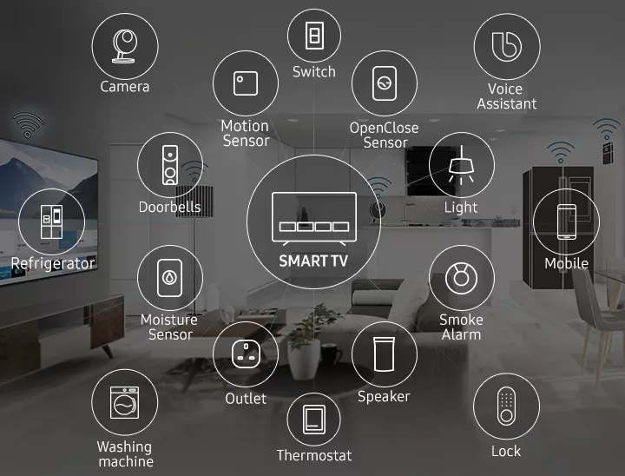
Let Us Look At Some Smart Home Devices.
https://www.samsung.com/de/tvs/smart-tv/smart-home-with-iot-devices/

Slide 8
How Smart Home’s Appliances Actually Work??
Camera : A smart camera tracks the happenings in home and uses Wi-Fi network to transmit the video to smartphone or cloud storage for the archive.
Smart Refrigerator : A smart refrigerator has Internet access and is able to recognize and manage items stored inside it. Automatic detection requires a barcode or RIFD on each item, or items can also be registered manually. A smart refrigerator allows a user to know which items are inside the refrigerator without opening it, by simply checking the display list on an LCD or other output device
Washing Machine : Smart washing machines and dryers can connect to a network via wi-fi. Auto-dosing washing machines can automatically dose detergent and fabric conditioner. The machine will adjust the amount it adds depending on certain factors about washing, like how dirty or heavy clothes are.

Slide 9
Smart light : With their wide range they operate effectively in lighting conditions ranging from bright sunlight to a dark room. The sensors enable automatic light’s brightness in response to changes in the brightness of the ambient light.
Smoke alarm : Most smart smoke detectors are hybrid devices that detect smoke and heat as well carbon monoxide (CO. These are connected to home internet so these can send notifications via a smartphone app.
Thermostat : The smart thermostat works through heating system's boiler, the thermostat's main control, and an app downloaded into smart device. This app lets the resident adjust the temperature as he wishes. While the resident is away, It can also turn off heating or air conditioning system automatically.
Smart lock : Smart locks are keyless door locks that allow opening door without a physical key. A smart lock connects with home’s wi-fi network, which allows it to receive the code or smartphone command to lock or unlock.

Slide 10
References

